Slide 1



STESSIE MULTIPLIER EVENT in Ghent
Friday March 21st 2025

Slide 2

Erasmus+ KA220 - Cooperation partnerships Objectives
Increasing quality in the work, activities and practices of organisations and institutions involved, opening up to new actors, not naturally included within one sector;
Building capacity of organisations to work transnationally and across sectors;
Addressing common needs and priorities in the fields of education, training, youth and sport;
Enabling transformation and change (at individual, organisational or sectoral level), leading to improvements and new approaches, in proportion to the context of each organisation.

Slide 3




STESSIE was born…
https://www.sici-inspectorates.eu/Activities/Projects

Slide 4













Slide 5
‘STESSIE’ focuses on the European priority area ‘Inclusion & diversity
in all fields of education, training, youth and sport’:
the Programme will support projects that promote social inclusion and aim at improving the outreach to people with fewer opportunities, including people with disabilities and people with a migrant background, as well as people living in rural and remote areas, people facing socio-economic difficulties or any other potential source of discrimination based on sex, racial or ethnic origin, religion or belief, disability, age or sexual orientation. These projects will help addressing the barriers faced by these groups in accessing the opportunities offered by the programme, as well as contributing to creating inclusive environments that foster equity and equality, and that are responsive to the needs of the wider community.

Slide 6
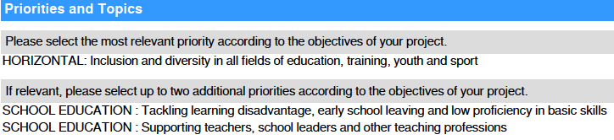
Priorities

Slide 7
Objectives
SO 1
Scientific evaluation, optimization and
translation of the toolbox for
(self-)evaluating and stimulating
social inclusion in education

Slide 8
Objectives
SO 2
Training of inspectors, evaluators, education providers,
school leaders and teachers
in the partner countries
on why they should and how they could use and interpret the toolbox TESSIE 2.0

Slide 9
Objectives
SO 3
Spreading of TESSIE 2.0
in different European regions:
actively participate on policy level
in the international debate about evaluation and quality improvement of social inclusion in education by raising awareness amongst the broader public about the existing tool and spreading the use of it.

Slide 10
Project PLANNING
 | 2023 | 2024 | 2025
Jan
Feb | Kick-off - Brussels | TPM5 (online) | TPM9 (online)
Ma | TPM1 (online) | TA3 Basque Country + ME3 | TA6 Flanders + ME6
Apr | IT-TPM | IT-TPM
May | TPM2 (online) | TPM6 (online) | TPM10 (online)
Jun | TA1 Poitiers + ME1 | TA4 Bulgaria + ME4 | TA7 Estonia + ME7
Jul
Aug
Sep | TPM3 (online) | TPM7 (online) | TPM11 (online)
Oct | TA2 Malta + ME2 | TA5 Serbia + ME5
Nov | IT-TPM |  | MULTIPLIER EVENT 8 (SICI)
Dec | TPM4 (online) | TPM8 (online) | Final meeting - Ghent

Slide 11
STESSIE expected results
The concrete results must be:
1) Scientific evaluated and upgraded TESSIE 2.0 framework
2) Scientific evaluated and upgraded TESSIE 2.0 (self-)evaluation and inspection tools and approaches in different systems
3) Professional online platform and online applications for all devices
4) Training and formation guidelines
5) Manual with criteria and strategy for internal evaluation
6) Manual with strategy for raising awareness and informing policy makers
7) Video for the promotion of the TESSIE 2.0 tools

Slide 12
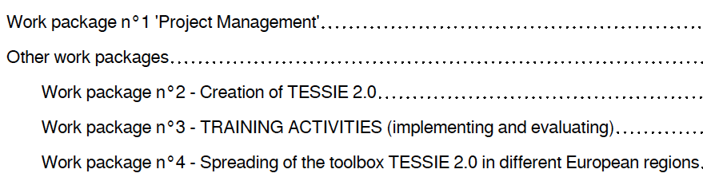
4 workpackages

Slide 13
WORKPACKAGE 2 : CREATION OF TESSIE 2.0
1. Scientific evaluation of TESSIE
2. Optimization of TESSIE
Ghent University will take the lead for the assessment and research work
IH2EF will take the lead for the creation of the online application and for making the formation and training
guidelines.

Slide 14
WORKPACKAGE 2 : CREATION OF TESSIE 2.0
Evaluation and assessment of TESSIE on a systemic European level (University Ghent)
Professional website building (SICI)
Developping a solidly configured online application, useful on
computers and other devices (phones, tablets…) (IH2EF)

Slide 15
TRAINING ACTIVITIES
(implementing and evaluating)
Specific objectives:
Training of inspectors, evaluators, education providers, school leaders and teachers in the partner countries
2) Translation of the toolbox and the formation and training guidelines
7 training activities
14 mobilities for external experts

Slide 16
TRAINING ACTIVITIES
(implementing and evaluating)
Specific objectives:
1) Training of inspectors, evaluators, education providers, school leaders and teachers in the partner countries
2) Translation of the toolbox and the formation and training guidelines
TRANSLATIONS
Dutch, Bulgarian, English,
French, Estonian, Serbian,
Spanish, Valencian, Basque

Slide 17
TRAINING ACTIVITIES
(implementing and evaluating)
Training activities with:
'pilots/jobshadowing in schools’
2 persons from each partners
2 invited experts (INGESSIE).
professionalization in a team has a greater impact
greater influence in the dissemination with colleagues
4 parts
Part 1: Workshop with the highlights of the (national) educational and supervisory system of external evaluation with focus on inclusive education in schools.
Part 2: Workshops with the input of the invited experts.
Part 3: 'peer-training’ or job-shadowing' in schools (at least 4 or 5 visited schools).
Part 4: Reflection sessions (swotanalysis).

Slide 18
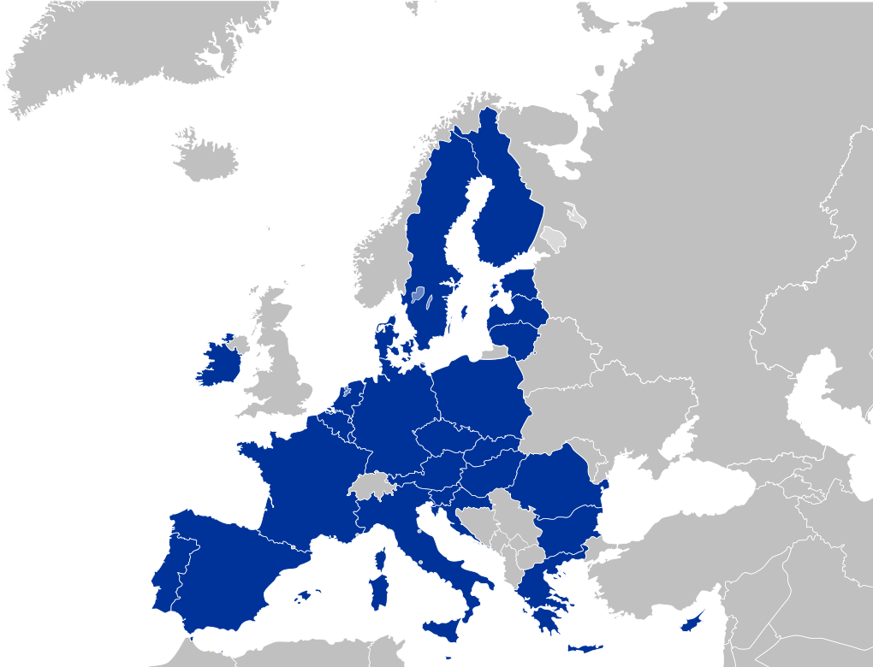
Spreading the toolbox TESSIE 2.0
Objectives:
1. Spreading of the toolbox TESSIE 2.0 in different European regions
2. Actively participate on policy level in the international debate about evaluation and quality improvement of social inclusion in education by raising awareness amongst the broader public and by using the TESSIE 2.0 tools.
Multiplier event
(after each training activity) for all stakeholders,

Slide 19

stessie website
https://www.sitemn.gr/stessie/

Slide 20


Slide 21
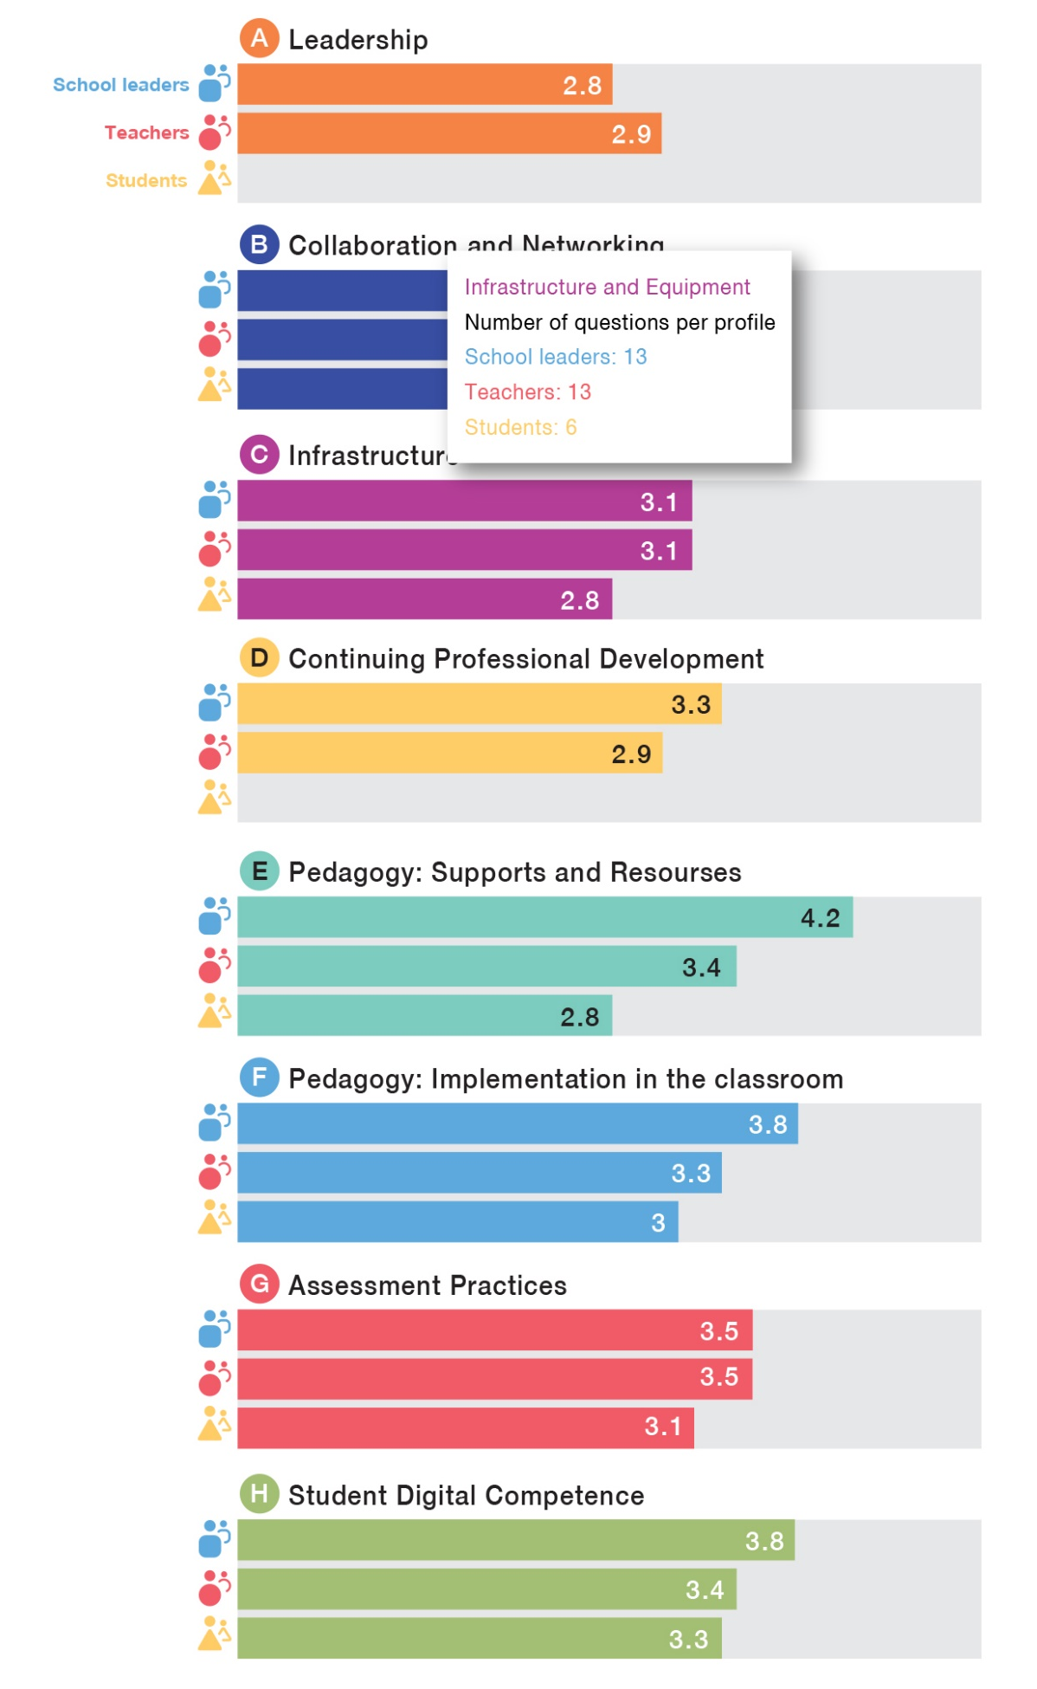

/ COMMON GOAL : CREATING A DIGITAL APP
On the model of the European Commission tool « SELFIE »
Transforming TESSIE into a « TESSIE-meter »
Giving datas to the schools for self evaluation
Identifying areas of improvement and guidance
https://education.ec.europa.eu/fr/selfie

Slide 22
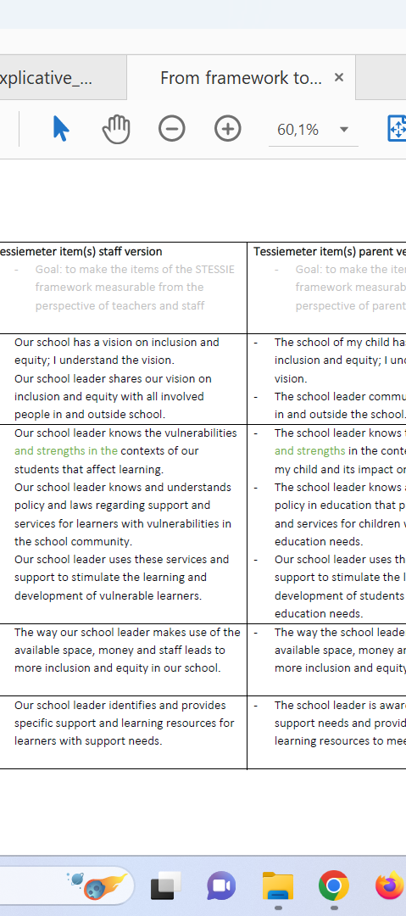

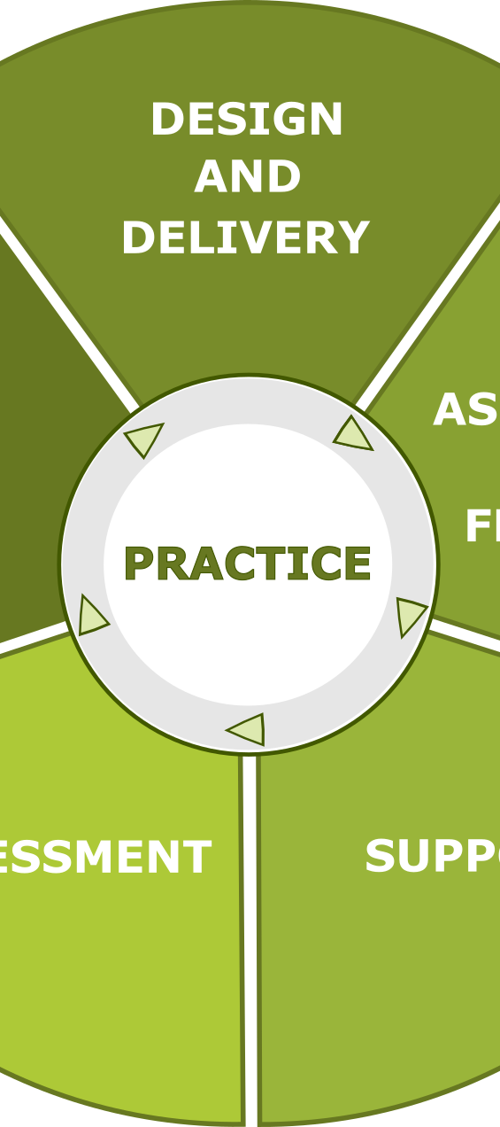

/ ADAPTATING « TESSIE »
USER FRIENDLY
LANGUAGE ISSUES
USEFUL FOR SCHOOLS
Notes:
Leadership and improving quality

Slide 23
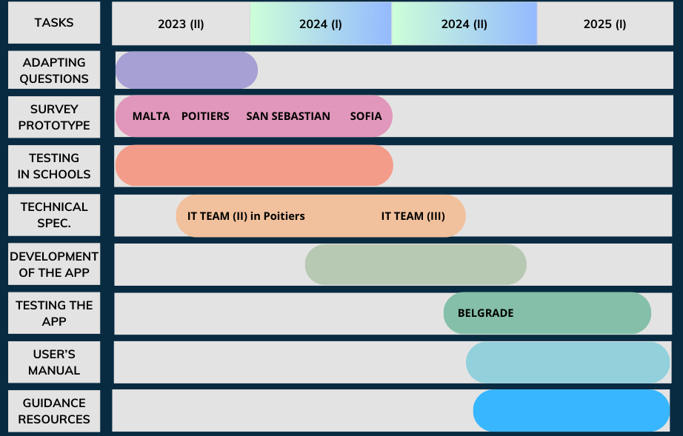
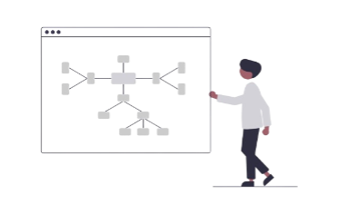
A long time process

Slide 24
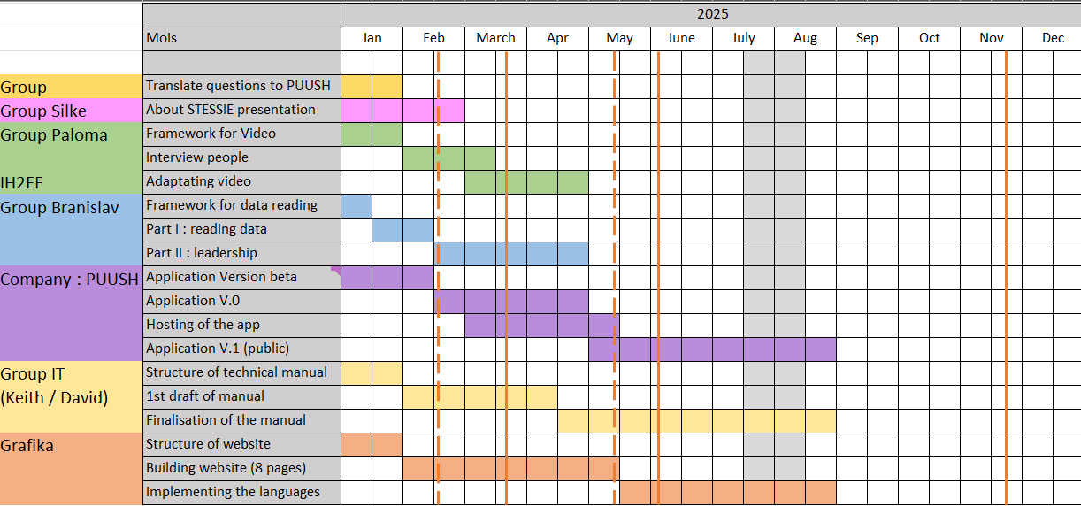
2025: … finish line !

Slide 25
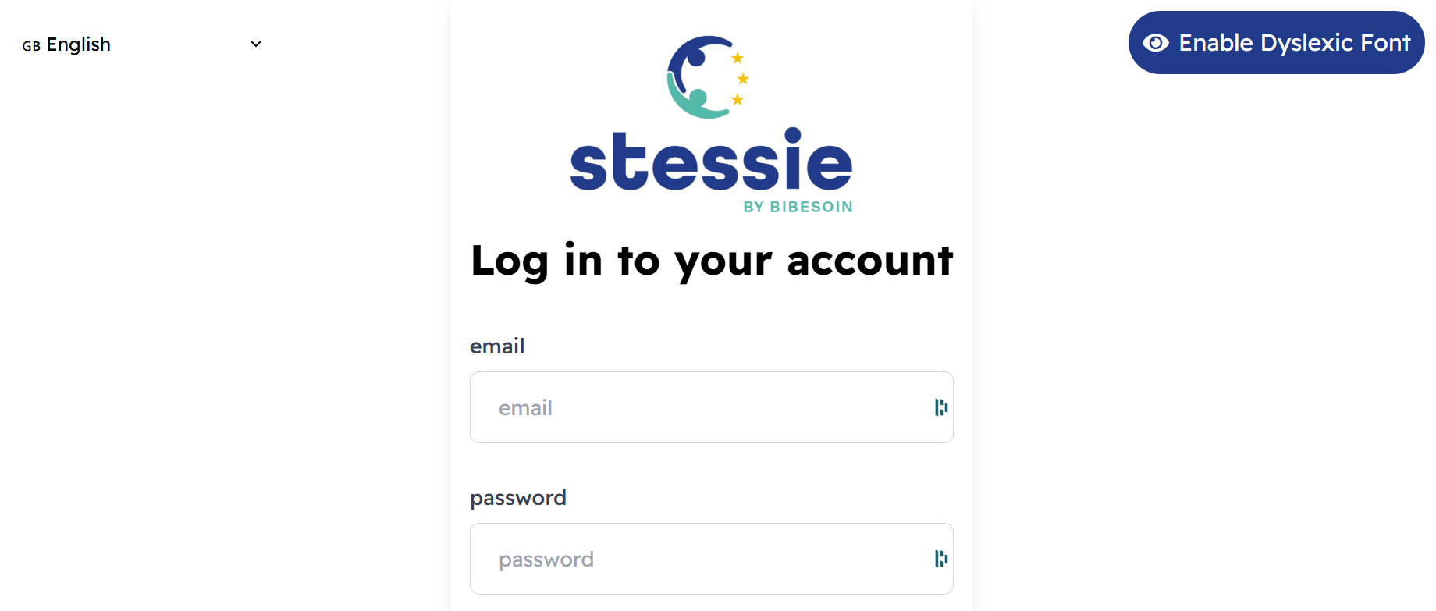
/ DISCOVERING OUR APPLICATION

Slide 26
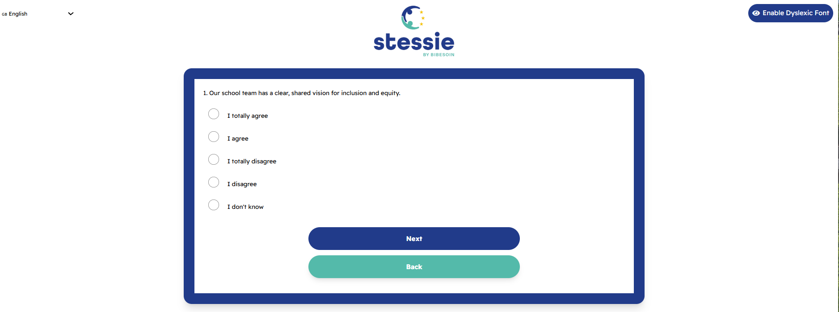
/ DISCOVERING OUR APPLICATION

Slide 27
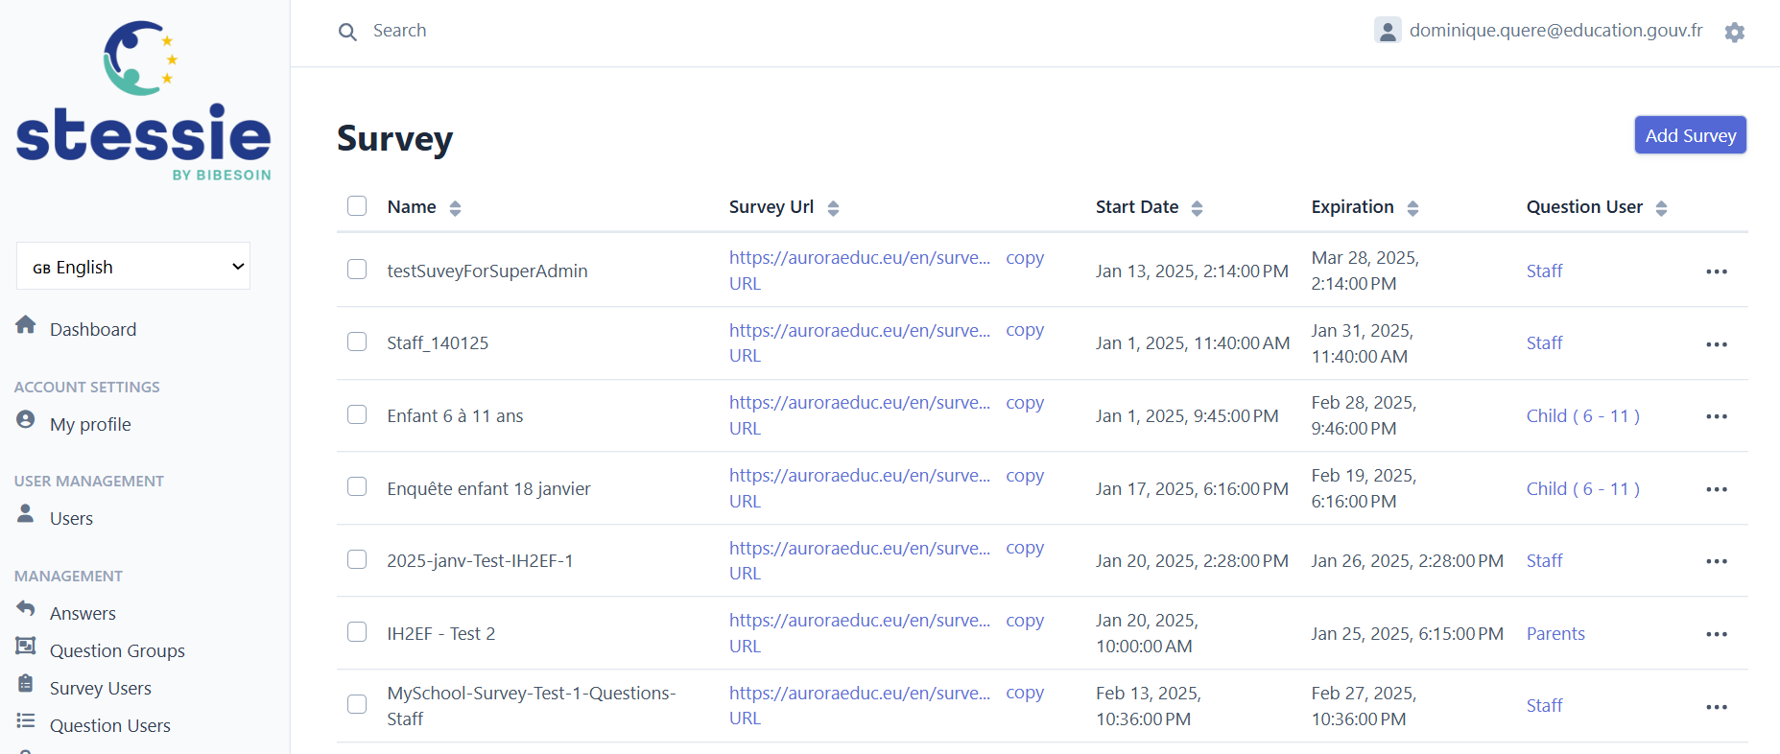
/ DISCOVERING OUR APPLICATION

Slide 28
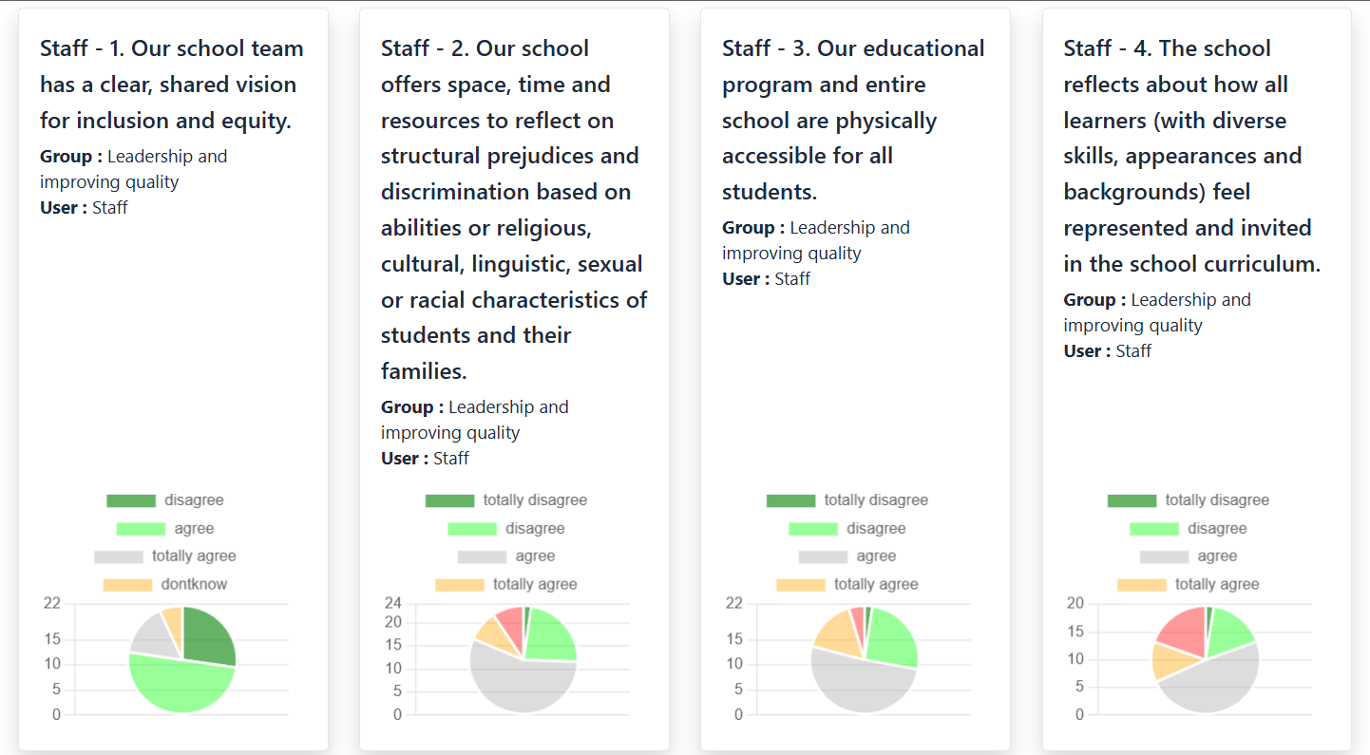
/ DISCOVERING OUR APPLICATION
Export in PDF
Export in XLS

Slide 29

/ GUIDANCE FOR DIRECTORS
User’s manual
Technical access for directors
Videos
Guidance
Professional development
Testimonies
A better understanding on management skills
Data literacy
Leadership / Management

Slide 30

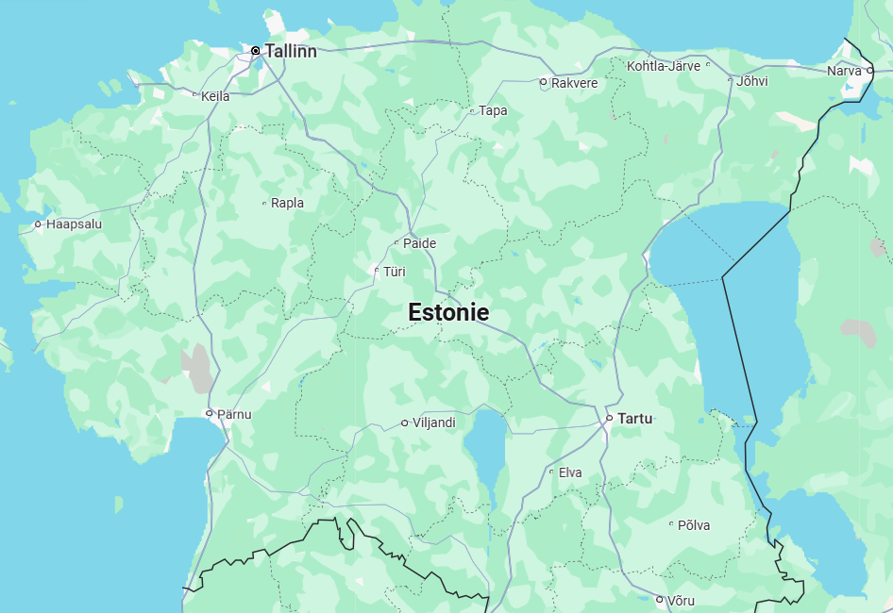
/ NEXT STEP…
Final application
Testing « in real life »
Providing correct and useful datas
School directors professional development
Varsti kohtumiseni Eestis!

